Slide 1
EZducate • Flash Cards
Dynamic Flash Cards: From Static Cards to Real-World Words
An EZducate origin story for visual learning & generalization

Slide 2
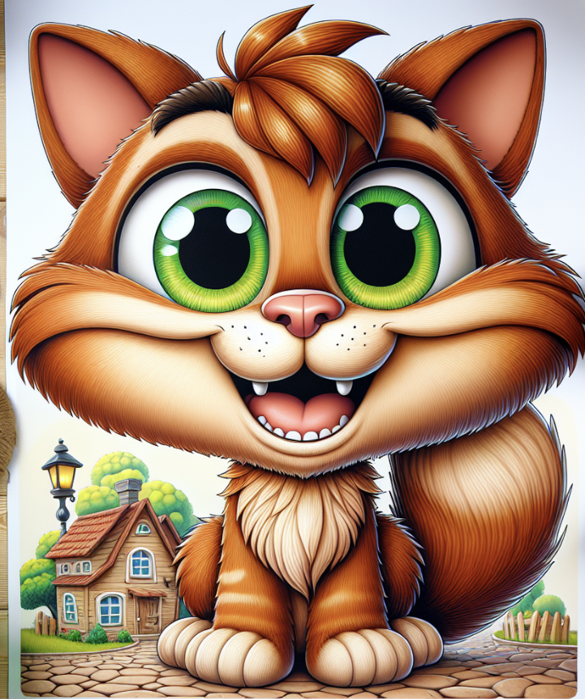
EZducate • Flash Cards
The Problem with Static Cards
The Problem with Static Cards
One perfect picture locks a concept (e.g., cartoon cat only).
Real life doesn’t match → no label, no carryover.
It’s not the child—it’s the input.
Before: single cartoon cat (square)

Slide 3
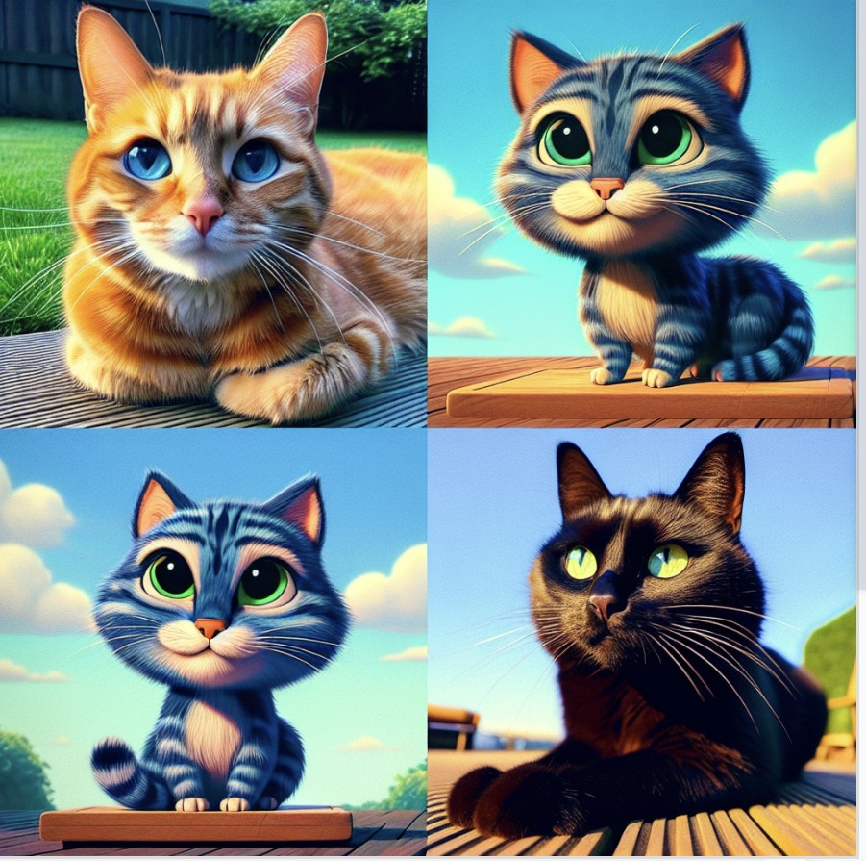
EZducate • Flash Cards
Our EZducate Origin Story
Our EZducate Origin Story
We built a way to make cards on the spot—photos, cartoons, icons.
Show many looks of the same idea so the word can travel.
Invite the child to help you create the flash card : pick, sort, and group.
After: many cats—photo + cartoon + close/far (square)

Slide 4
EZducate • Flash Cards
The Variety Recipe (Generalization Unlocked)
Build a Variety Pack
Formats: photo, cartoon, icon, silhouette
Angles & Distance: close-up, side view, full body, far away
Attributes: color, size, texture (fluffy/sleek), long/short hair
Contexts: home, school, store, outdoors
Actions/States: sleeping, jumping, eating, hiding, being carried
Tricky Cases: partial view, behind objects, night vs day

Slide 5

EZducate • Flash Cards
Co-Creation Changed Everything
Co-Creation Changed Everything
Ownership → attention, pride, and longer engagement.
Vocabulary grows; verbs and adjectives follow.
Short frames become tiny stories (The cat is sleeping).
Insert photo of child selecting cards (square)

Slide 6
EZducate • Flash Cards
Imagination → Inference
Make-Believe Builds Meaning
Create anything: astronaut cats, shy teacups, singing buses.
Joy fuels practice; pretend lowers pressure, real photos ground it.
Practice inference with prompts: What’s happening? What’s next? Why?
Use ‘because’ / ‘so that’ frames to link reasons and outcomes.

Slide 7
EZducate • Flash Cards
Early Intervention: Speech & OT (Used Appropriately)
What Helped
Speech (SLP): tiny rhythmic frames; model → expand → mini-stories.
OT: regulation supports (headphones, breaks, timers), clean visuals first.
Pace sessions: short sets + movement breaks = sustainable.

Slide 8
EZducate • Flash Cards
Our 10-Minute Routine (Start Today)
Pick a concept
Generate variety
Co-create
Name & sort
Language play
Real-world match
Swap 2 images
cat, bus, help, wait, clean up
10–20 images with different looks
Child picks 6–8 keepers
Group by simple feature
2–3 frames (repeat)
Find a ‘Same!’ moment
Keep it fresh next time

Slide 9
EZducate • Flash Cards
Micro-Sessions for Busy Days (≈5 minutes)
Quick Wins
Contrast pair: This is a bus. This is not a bus (it’s a truck).
Two-panel story: Line up → doors open. What happens next?
Feeling check: calm vs worried—Which one is you?
Because frame: Headphones on because it’s loud.
Choice hook: you pick the next picture.

Slide 10
EZducate • Flash Cards
Troubleshooting (Kind Fixes)
If It’s Not Sticking…
Only labels one picture → add three new looks (keep the favorite).
Overwhelmed → start with clean backgrounds; add one distractor later.
Mixes up bus/truck → use contrast pairs; name both clearly.
Attention fades → child chooses the next image; co-creation = attention.
Stuck at single words → add one sentence frame and repeat.

Slide 11
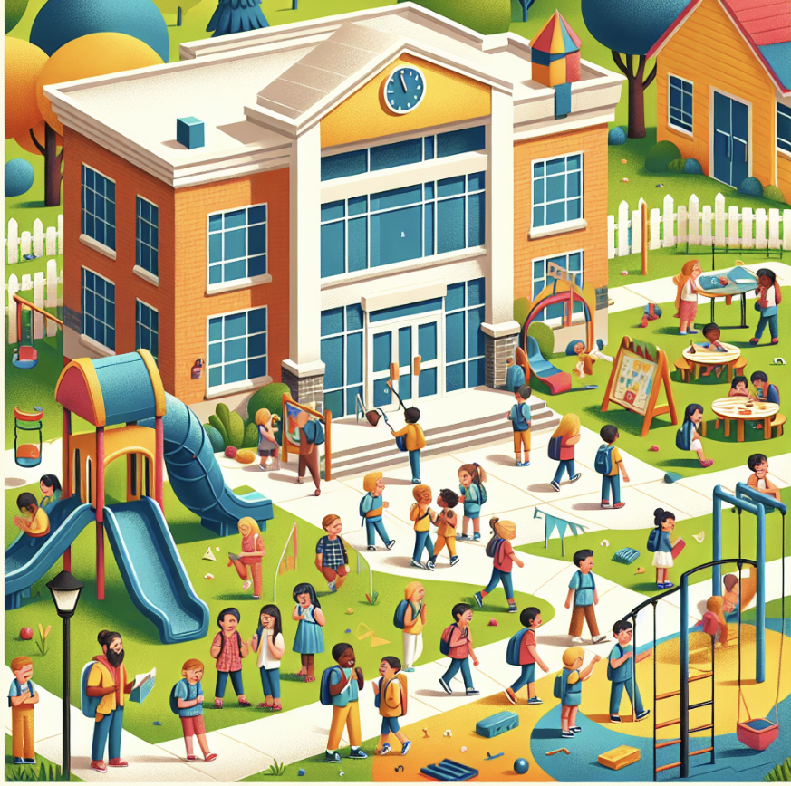
EZducate • Flash Cards
Home–School Bridge
Home–School Bridge
Share a small, authentic photo bank (school lobby, clinic hall, local park).
Agree on one sentence frame for the week (The ___ is ___-ing).
Use the same images across cards, social stories, and schedules.
Keep data light and kind—track wins that change instruction.
Insert school/clinic photo placeholder (square)

Slide 12
EZducate • Flash Cards
Cards → Social Stories → Visual Schedules
One Visual Language
Learning cards build flexible meaning and quick practice.
Social stories add steps, feelings, and coping cues (pause, ask for help).
Visual schedules make the day predictable with simple blocks.
Reuse the same images across all three to build trust and carryover.

Slide 13
EZducate • Flash Cards
Why EZducate Flash Cards
Built for Real Life
Create on the spot: photos, cartoons, icons in seconds.
Template smart: concepts, actions, emotions, routines.
Co-create by design: kids pick, drag, reorder—ownership matters.
One-click export & share: printables, classroom boards, digital decks.
Aligned system: cards flow into social stories & visual schedules.

Slide 14
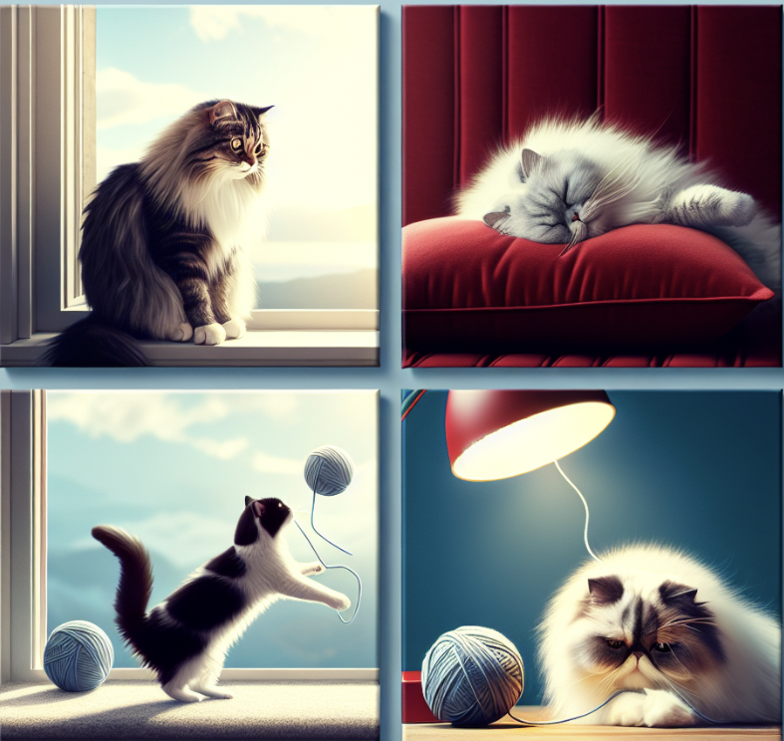
EZducate • Flash Cards
Starter Plan: CAT (With Speech & OT Carryover)
Practice Flow (≈10 minutes)
Labels → frames → inference → real-world match.
Frames to reuse: The cat is sleeping. The cats are eating.
SLP: model + expand the same frame all week.
OT: headphones if needed; short breaks; clean visuals first.
Add 3 square cat images here

Slide 15
EZducate • Flash Cards
Credits & Notes
Visuals & Tools
Visuals created with EZducate Flash Cards (swap placeholders with real outputs).
Keep outputs square (1:1) for consistent layout across cards and stories.
Optional footer: Visuals courtesy of EZducate — Flash Cards.

Slide 16
EZducate • Flash Cards
Tools, Not Tests
The win is language—and connection—that travel from a card to real life.

